Slide 2
Outline
Motivation
Problem setting
Proposed method
Experimental results
Conclusion

Slide 3
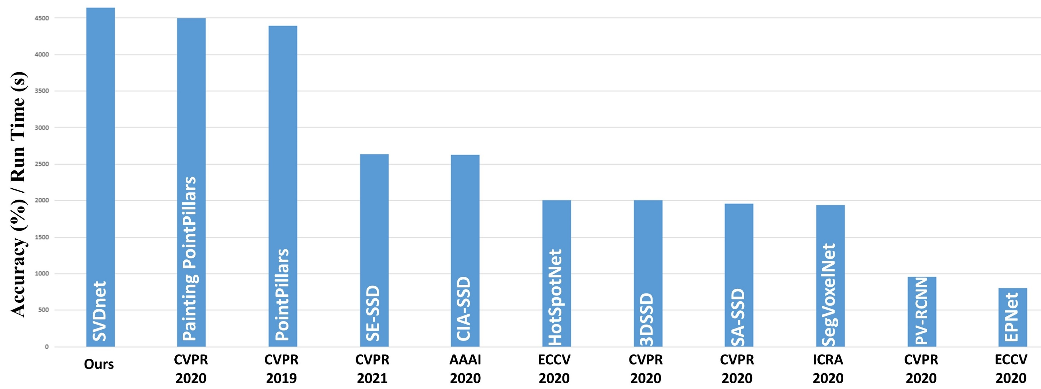
Motivation

Slide 4
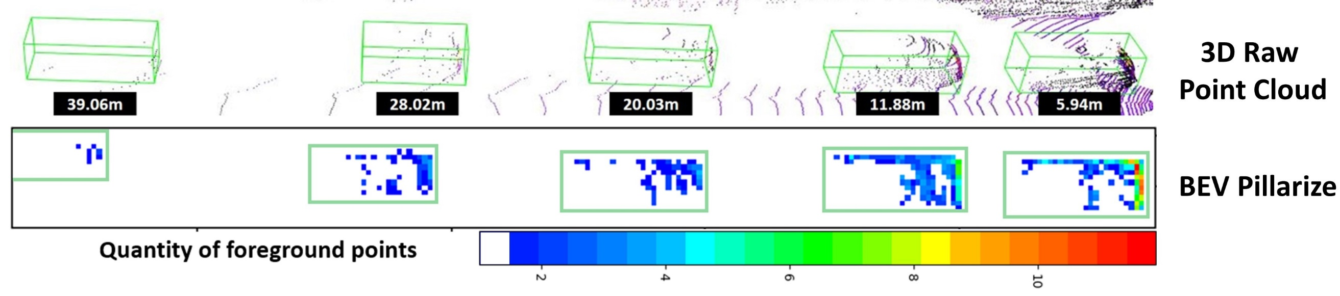
Problem setting

Slide 5
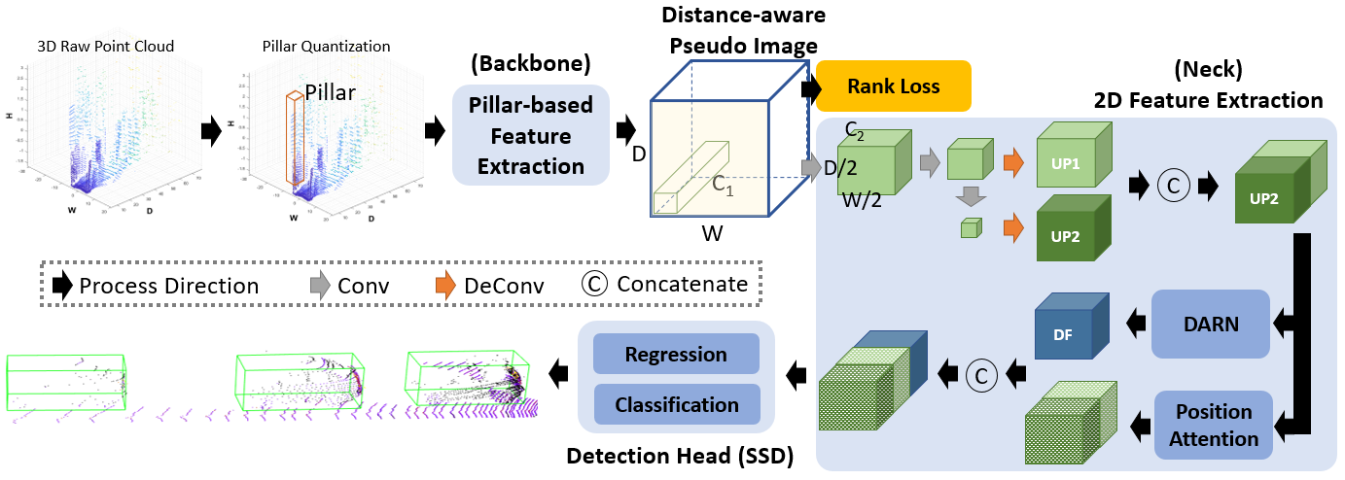
Proposed method

Slide 6
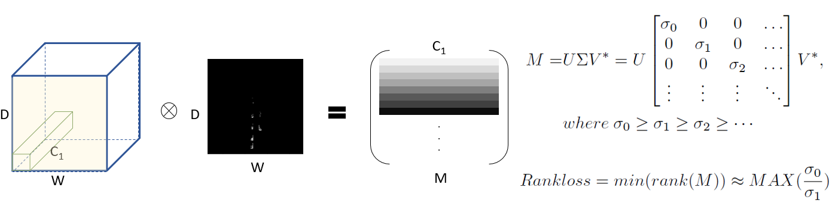
Proposed method

Slide 7
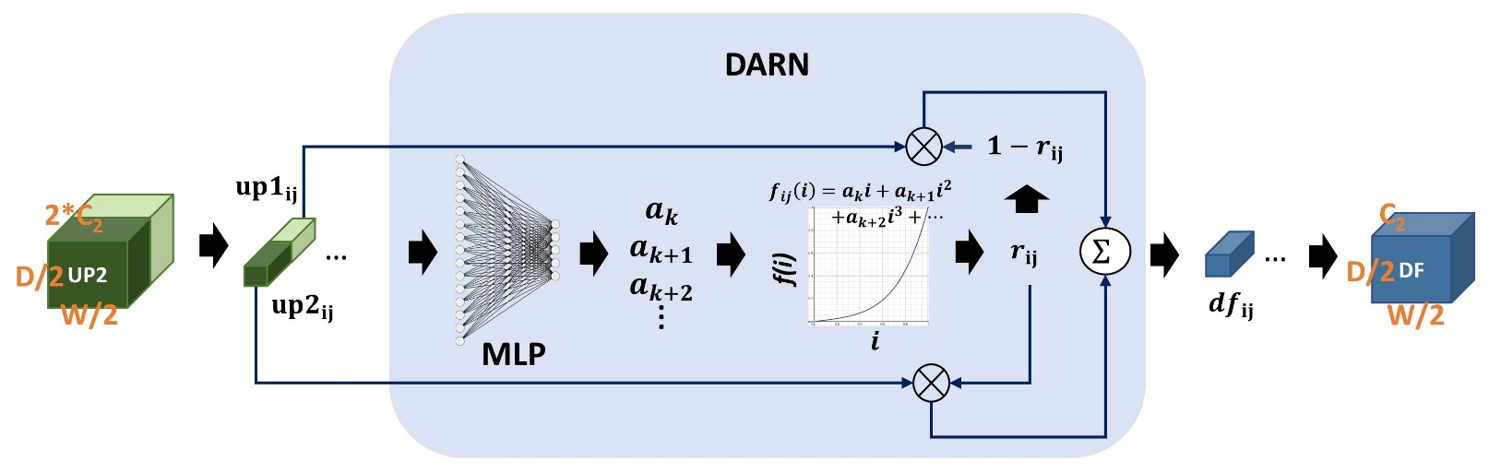
Proposed method

Slide 8
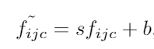
Proposed method
where i, j are the position indexes of one pillar in BEV and c is the index of the corresponding channel

Slide 9

Proposed method

Slide 10
Experimental result
KITTI Dataset
3712
3769
Training & validation
Testing

Slide 11
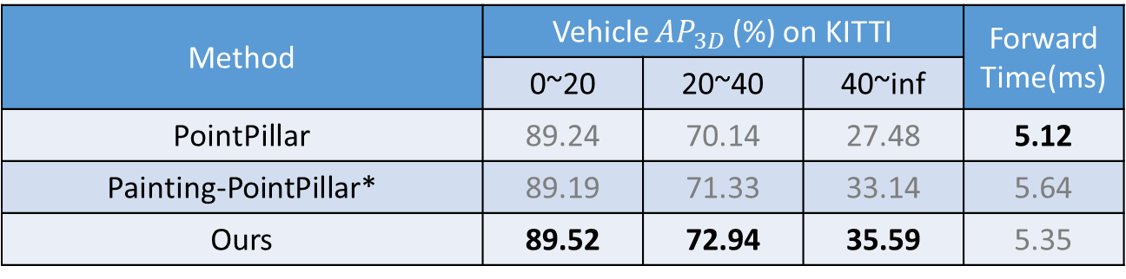
Experimental result
Method | Vehicle ${AP}_{3D}$ (%) on KITTI |  |  | Forward Time(ms)
 | 0~20 | 20~40 | 40~inf
PointPillar | 89.24 | 70.14 | 27.48 | 5.12
Painting-PointPillar* | 89.19 | 71.33 | 33.14 | 5.64
Ours | 89.52 | 72.94 | 35.59 | 5.35

Slide 12
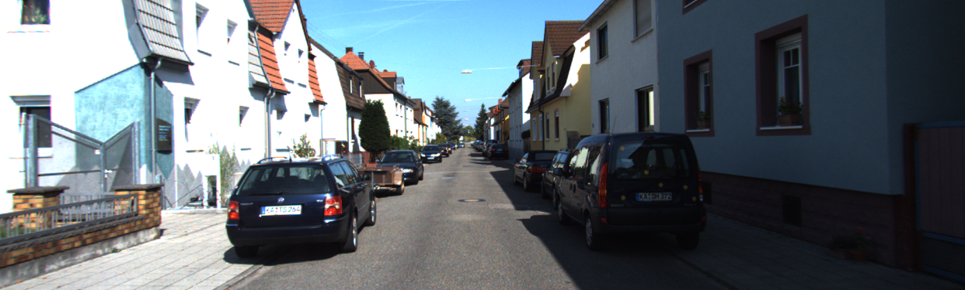
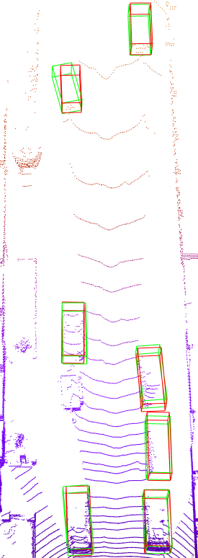
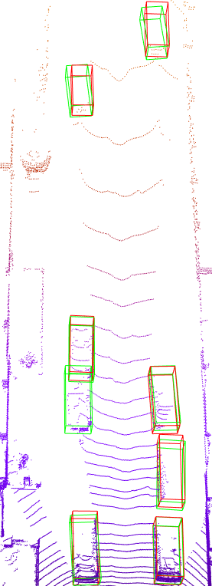
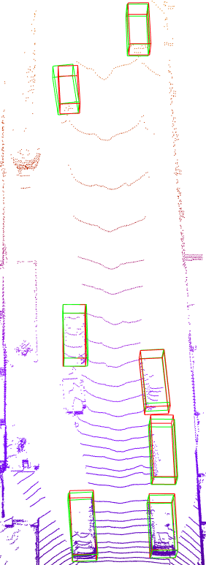
Experimental result
Vehicle GT
Vehicle Predict
PointPillars
SVDnet(ours)
Painting PointPillars

Slide 13
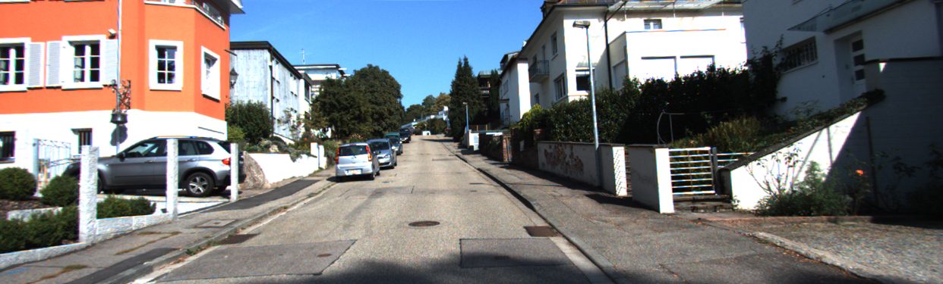
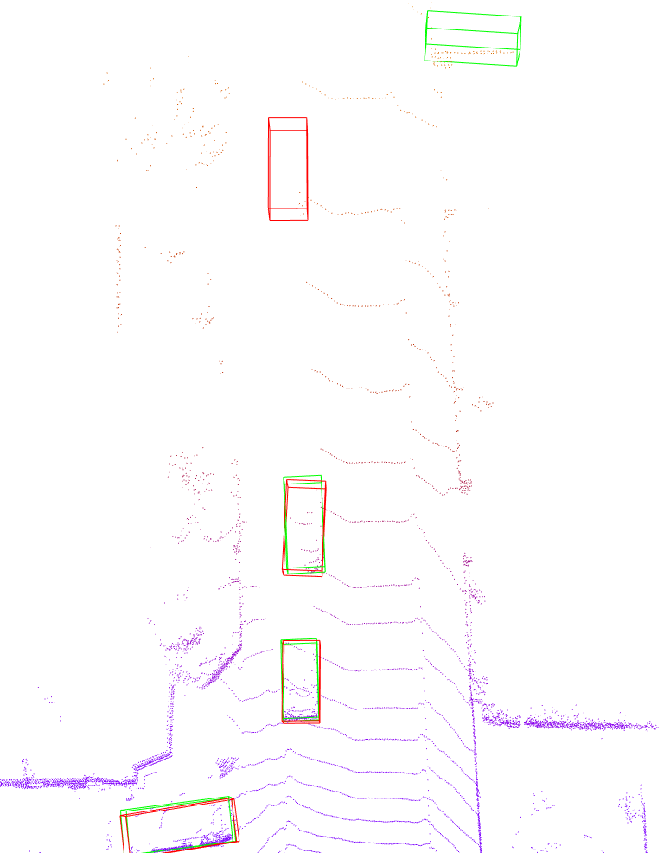
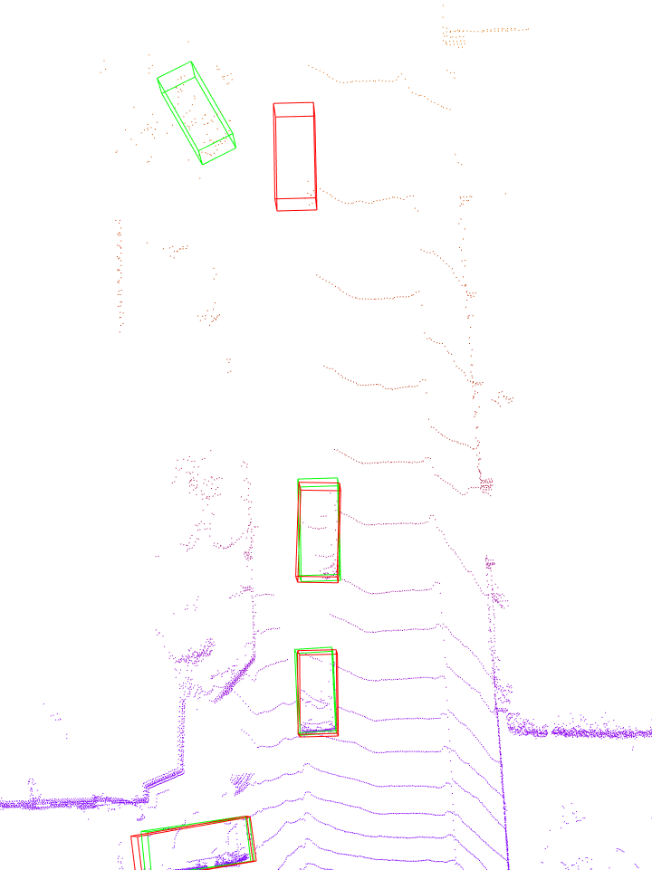
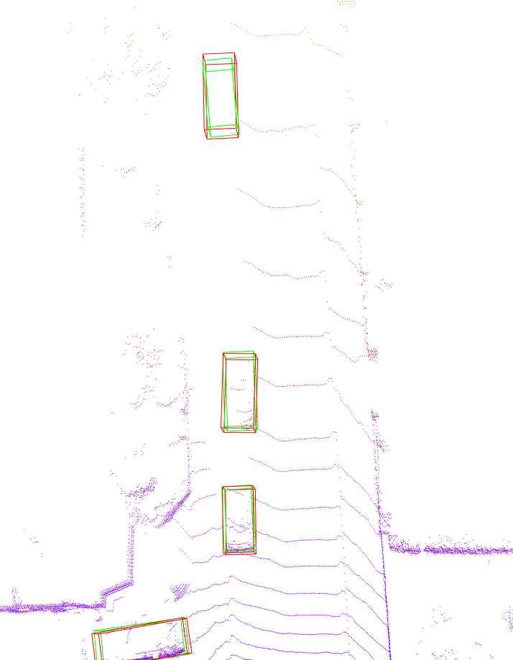
Experimental result
Vehicle GT
Vehicle Predict
PointPillars
SVDnet(ours)
Painting PointPillars

Slide 14
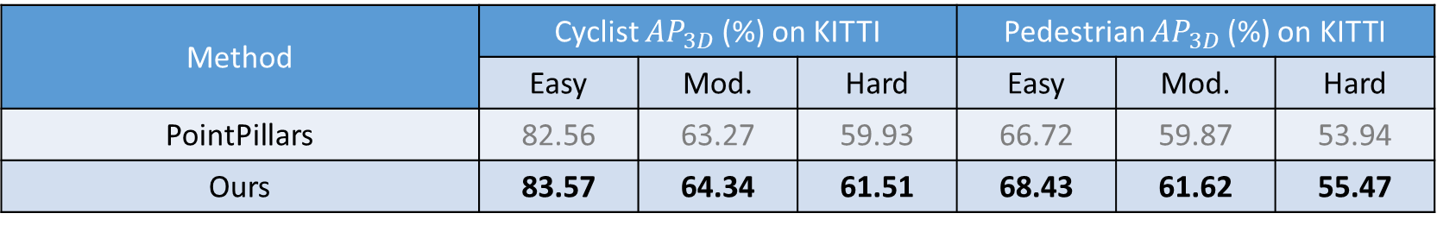
Experimental result
Method | Cyclist ${AP}_{3D}$ (%) on KITTI |  |  | Pedestrian ${AP}_{3D}$ (%) on KITTI
 | Easy | Mod. | Hard | Easy | Mod. | Hard
PointPillars | 82.56 | 63.27 | 59.93 | 66.72 | 59.87 | 53.94
Ours | 83.57 | 64.34 | 61.51 | 68.43 | 61.62 | 55.47

Slide 15
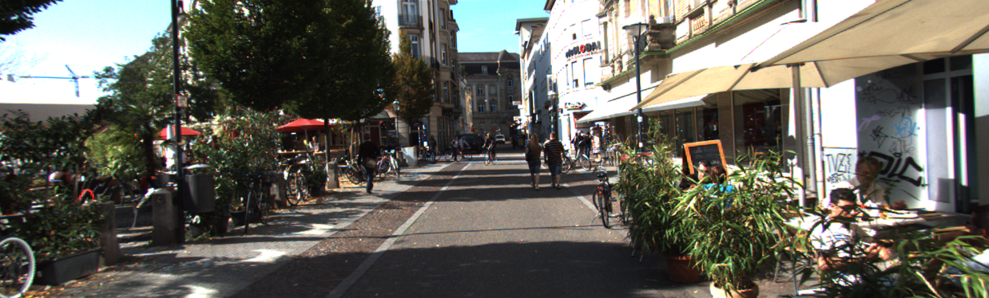
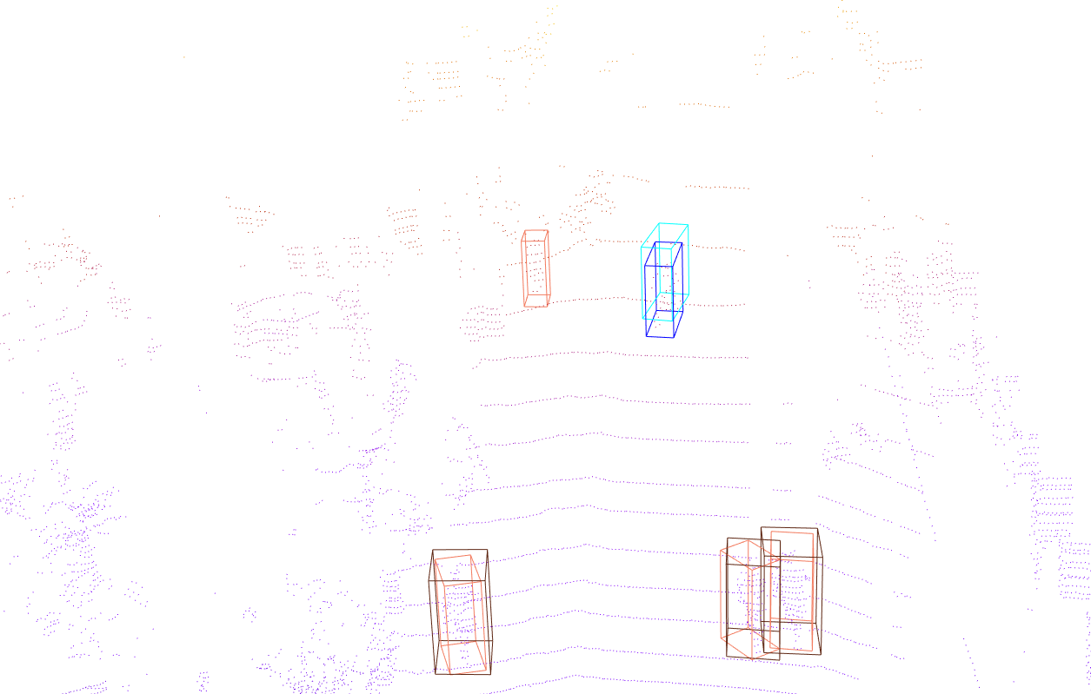
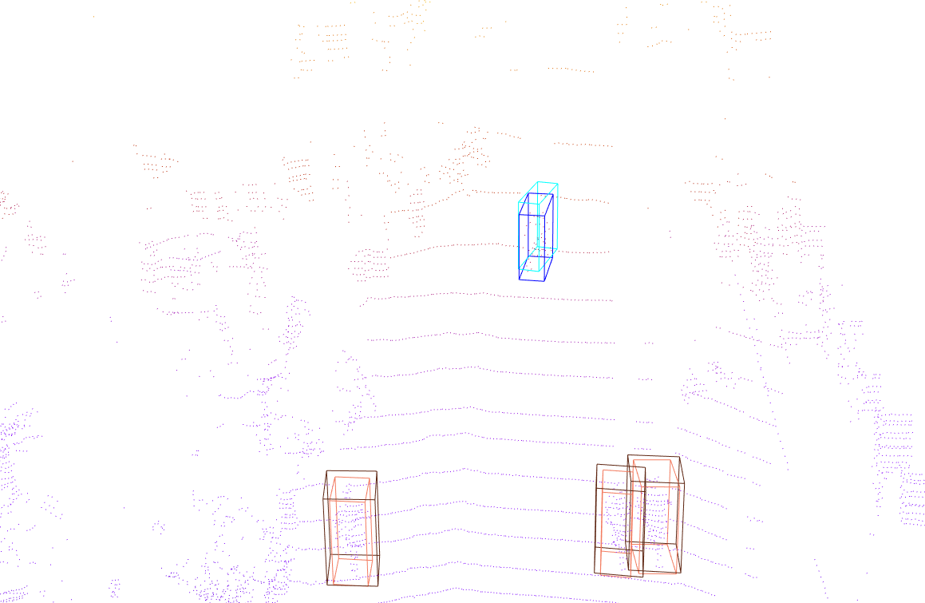
Experimental result
Pedestrian GT
Cyclist GT
Pedestrian Predict
Cyclist Predict
PointPillars
SVDnet(ours)

Slide 16
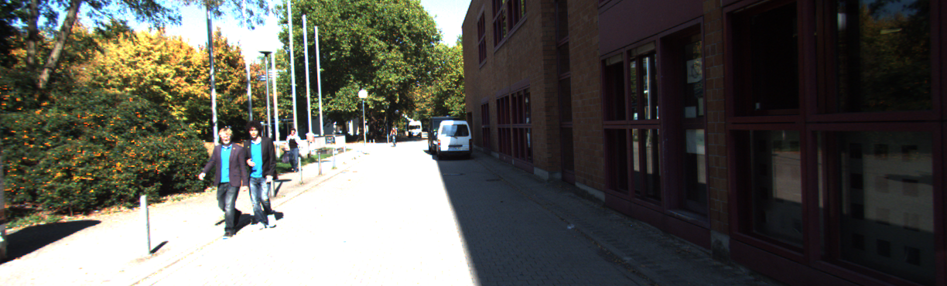
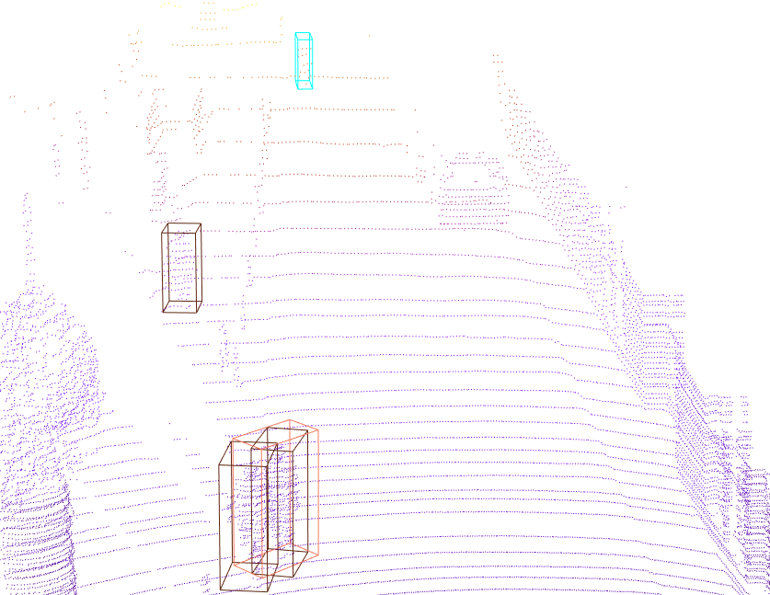
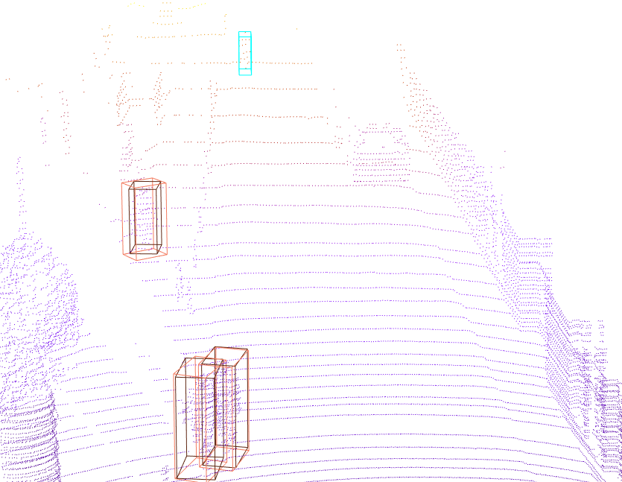
Experimental result
Pedestrian GT
Cyclist GT
Pedestrian Predict
Cyclist Predict
PointPillars
SVDnet(ours)

Slide 17
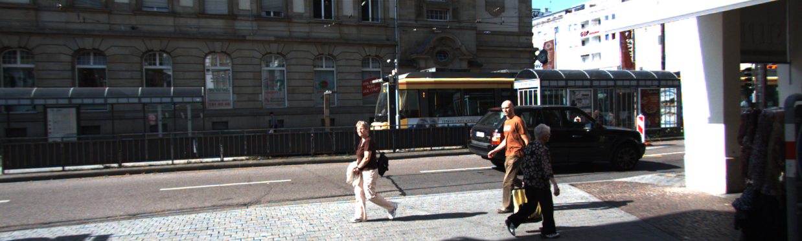
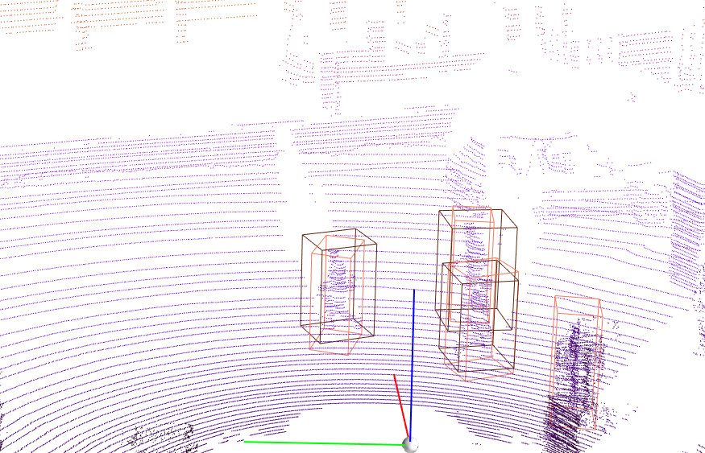
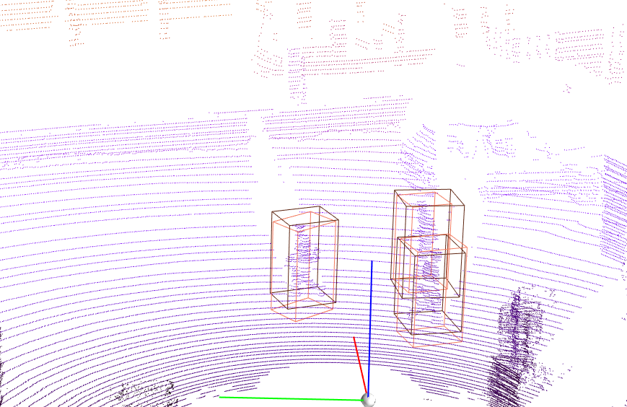
Experimental result
Pedestrian GT
Cyclist GT
Pedestrian Predict
Cyclist Predict
PointPillars
SVDnet(ours)

Slide 18
Conclusion
We introduce the novel rank loss in the network backbone to address the interference effects and help to purely derive distance-aware pillar features intrinsically embedded in the point cloud due to imbalanced sparsity. The distance-aware pillar features would be further refined in the neck.
We design two simple but efficient modules, position attention and DARN, to refine features accordingly to different distances and eventually provide a more robust and stable high-level representation for pillar-based 3D object detection.
The proposed SVDnet achieves a better detection performance on KITTI dataset in terms of accuracy and runtime. Moreover, the above three novel designs can be easily plugged into pillar-based methods with negligible speed drop.
There are more details in our paper.

